Slide 1
Solar Farm
Sammi Chong

Slide 2
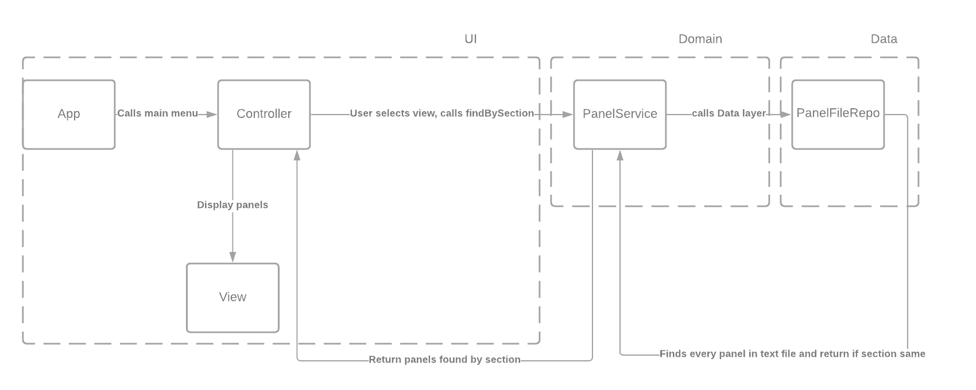

Slide 3
App
Make new objects for panelFileRepo, PanelService, ConsoleIO, View, Controller.
Call run() from Controller class.

Slide 4
Model
Material
Enum
Panel
Get/Set for panel attributes
int panelID;
String section;
int row;
int column;
int yearInstalled;
Material material;
boolean isTracking;

Slide 5
UI
Controller
Get menu option 1-4
View, add, update, delete
E.g view
Calls findBySection method from PanelService class in domain layer
This calls findBySection method in PanelFileRepo class in data layer. Returns panel to PanelService and Controller.
Controller calls view to display panels.
View
Display output to console
ConsoleIO
Printing and reading input
TextIO
Interface for ConsoleIO

Slide 6
Domain
Panel Result
Error messages and get/set panels
Panel Service
Validate rules
Calls data layer to apply changes to file

Slide 7
Data
DataAccessException
Custom exception
PanelFileRepo
Contains methods for adding, updating, deleting, viewing etc. file.
PanelRepo
Interface for PanelFileRepo

